Slide 1
A Probabilistic Seismic Hazard Model for Sub-Saharan Africa
Valerio Poggi¹, Graeme Weatherill¹, Julio Garcia¹, Marco Pagani¹
R. Durrheim², G. Mavonga Tuluka³, A. Nyblade⁴
1 - Global Earthquake Model (GEM), Pavia Italy
2 - University of the Witwatersrand, Johannesburg, South Africa
3 - Goma Volcanic Observatory, DR Congo
4 - Penn State University, USA
June 30, 2016, Addis Ababa - Ethiopia

Slide 2
Introduction to GEM
GEM (Global Earthquake Model) is a no-profit organization funded by public and private partners aimed to stimulate the awareness on seismic hazard and risk worldwide
The overall goal of the hazard component of the GEM community is:
the construction of a global mosaic of open hazard models
to provide the community with tools, datasets and knowledge to achieve this goal

Slide 3
GEM’s Philosophy
All GEM products (models, software, databases, training material) are meant to be:
Collaborative
We promote interaction and collaboration between scientists, professionals and experts from African institutions and worldwide
2) Open and transparent
All input information, data and results are openly accessible to the community for verification, improvement or any other use

Slide 4
GEM’s Philosophy
Why is it useful?
Transparency and reproducibility can increase acceptability
It can reduce erroneous criticism
Testing becomes a more effective process (feedback process, identification of bugs…)
Only in this way it’s possible to ensure long term maintenance, incorporate newest ideas and features and aim at a large community of users

Slide 5
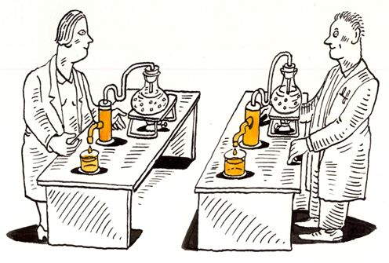
Reproducibility in Seismic Hazard
What’s a reproducible PSHA model?
The basic information used for its construction is openly accessible on public repositories
The tools used for the construction of the hazard model are accessible on a public repository
The model building process is documented in a way that an independent modeller will be able to reproduce the model
The calculation are performed with a freely accessible software (possibly open-source)

Slide 6
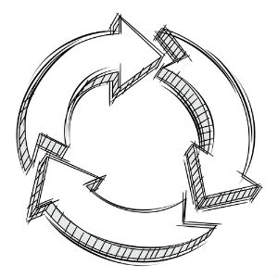
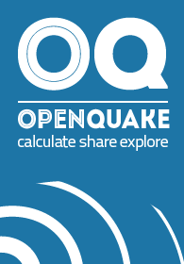
GEM Hazard - Open Products
Basic datasets
Tools for pre-processing data and build models
QA and testing
GEM COMMUNITY
Hazard calculation engine
Hazard models
database

Slide 7
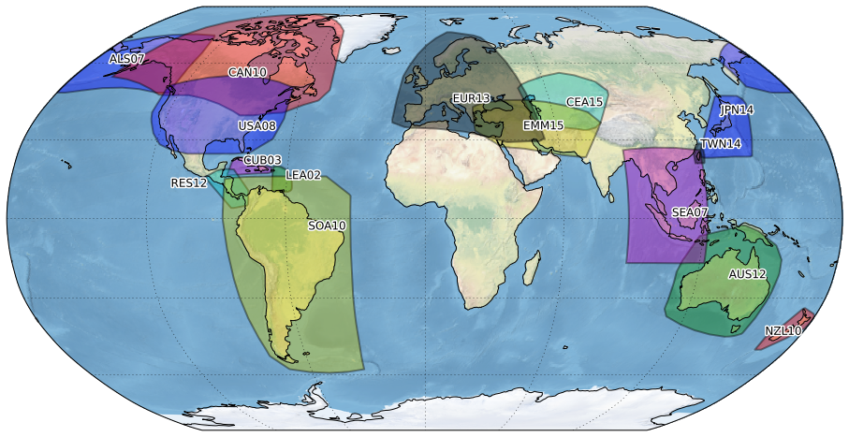
GEM Global Database of Hazard Models
Europe - SHARE
Central
Asia - EMCA
Alaska
Japan
USA
Middle
East - EMME
Cuba
Central
America
Lesser
Antilles
Taiwan
South America
SSAHARA
South East Asia
New
Zealand
The DB contains hazard models developed by national agencies and international projects which are openly distributed

Slide 8
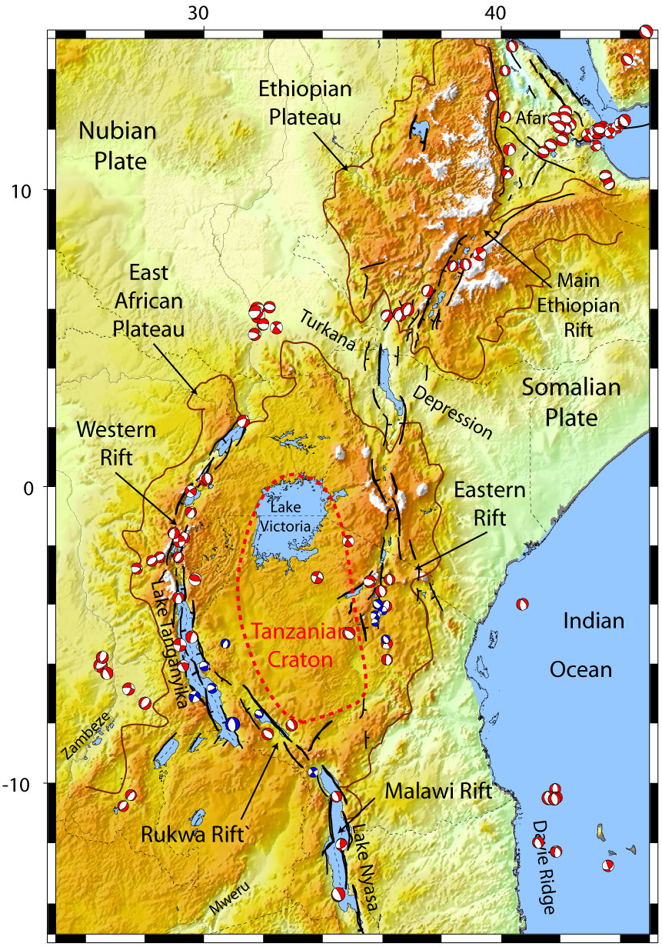
Earthquake Hazard in Sub-Saharan Africa
The East African Rift System (EARS) is the major active tectonic feature of the Sub-Saharan Africa (SSA) region
Several past large earthquakes caused a non-negligible level of damage
A reliable risk assessment is therefore essential, which requires a state-of-art hazard assessment for the region
There is a need for a new probabilistic seismic hazard model based on the most recent and up to date available information

Slide 9
The Sub-Saharan Africa Hazard Model
Sub-Saharan Africa (SSA) Hazard Model is a pilot project led by GEM and AfricaArray and supported by U.S. AGENCY FOR INTERNATIONAL DEVELOPMENT (USAID)
Original goals:
Development of an explorative hazard model for SSA region
Assess the usefulness of AfricaArray data for hazard mitigation
Available components / achievements:
Improved earthquake catalogue
Source zonation model and regional seismicity analysis
Strain rate model
Final hazard model

Slide 10
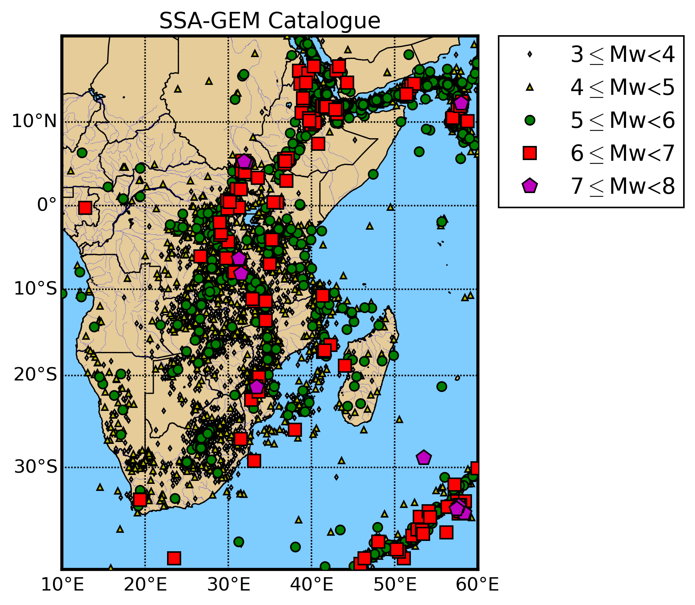
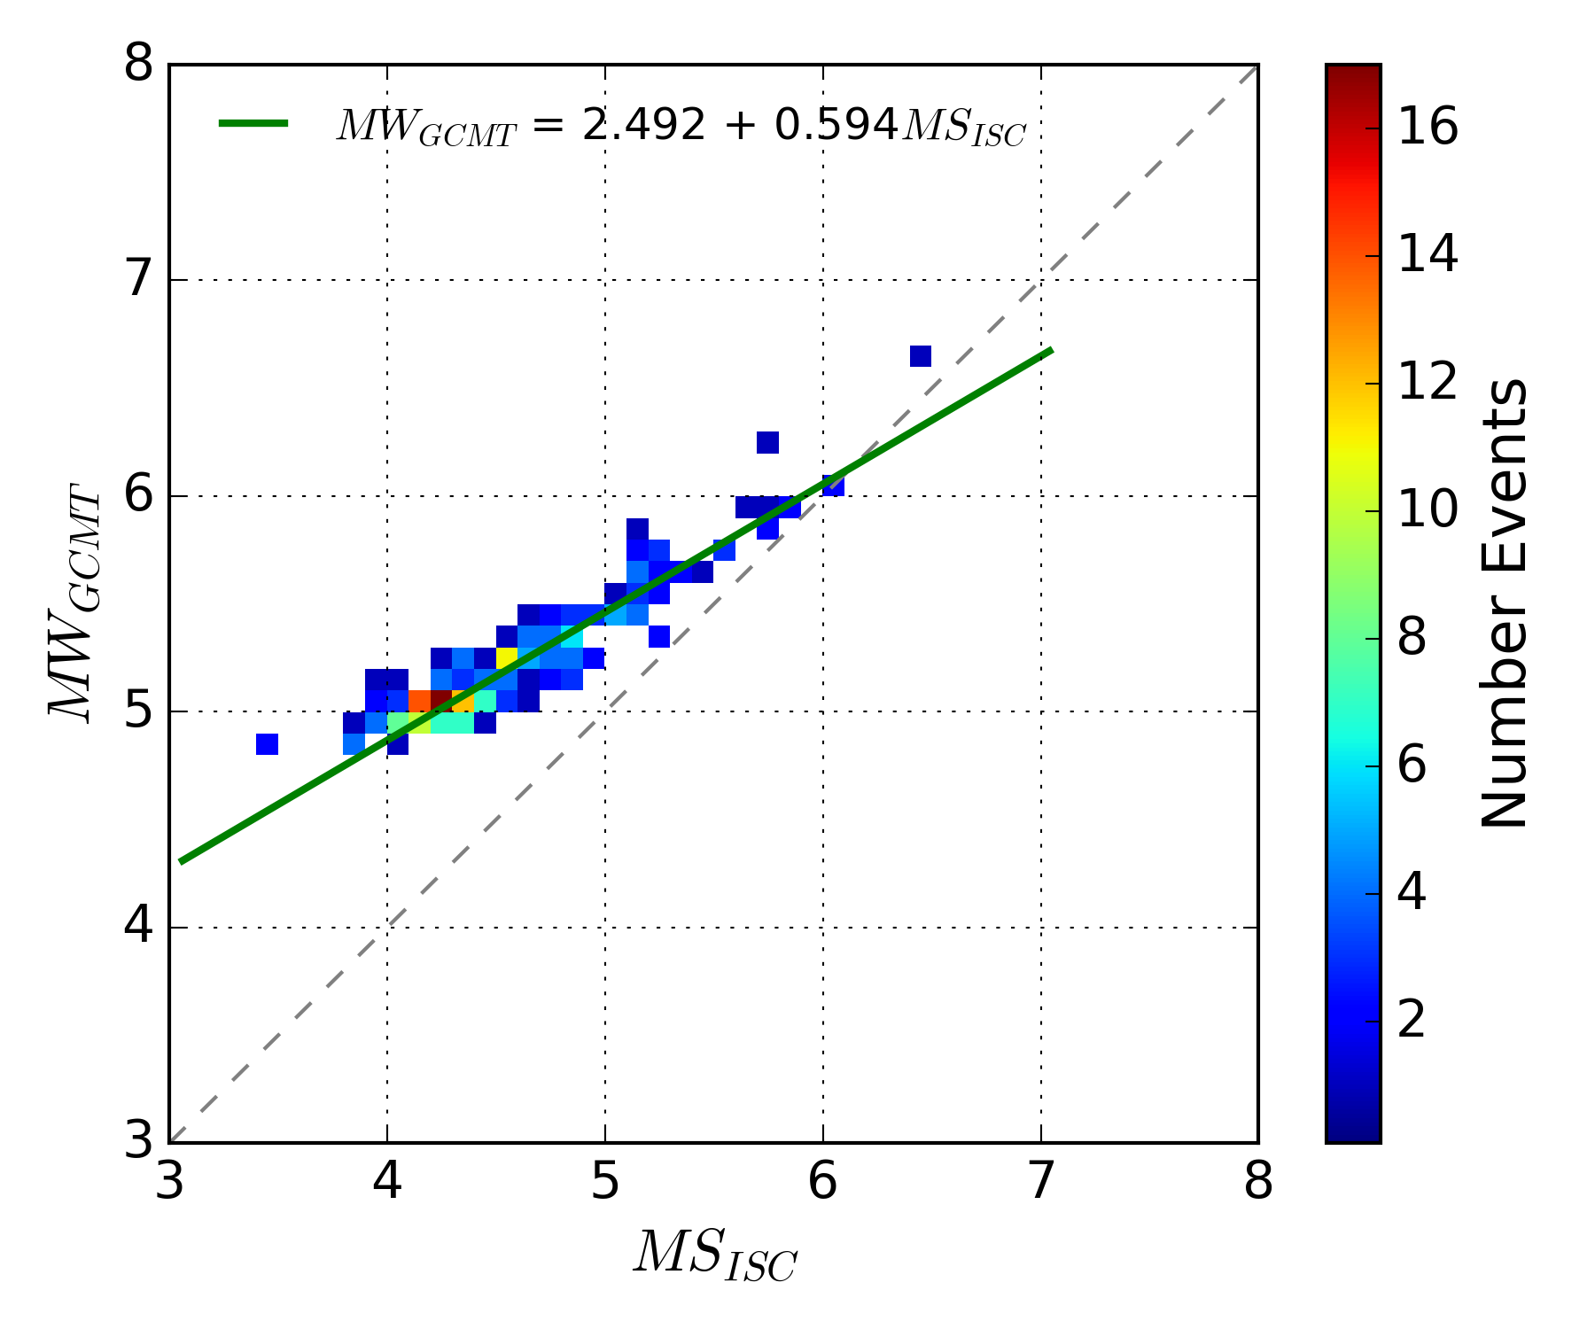
SSA Hazard Model – Improved Earthquake Catalogue
SSA Catalogue is obtained by harmonization of global bulletins with data from local agencies and regional projects, particularly from the AfricaArray framework
NEW!
29803 events
3 ≤ Mw ≤ 7.3
Mw

Slide 11
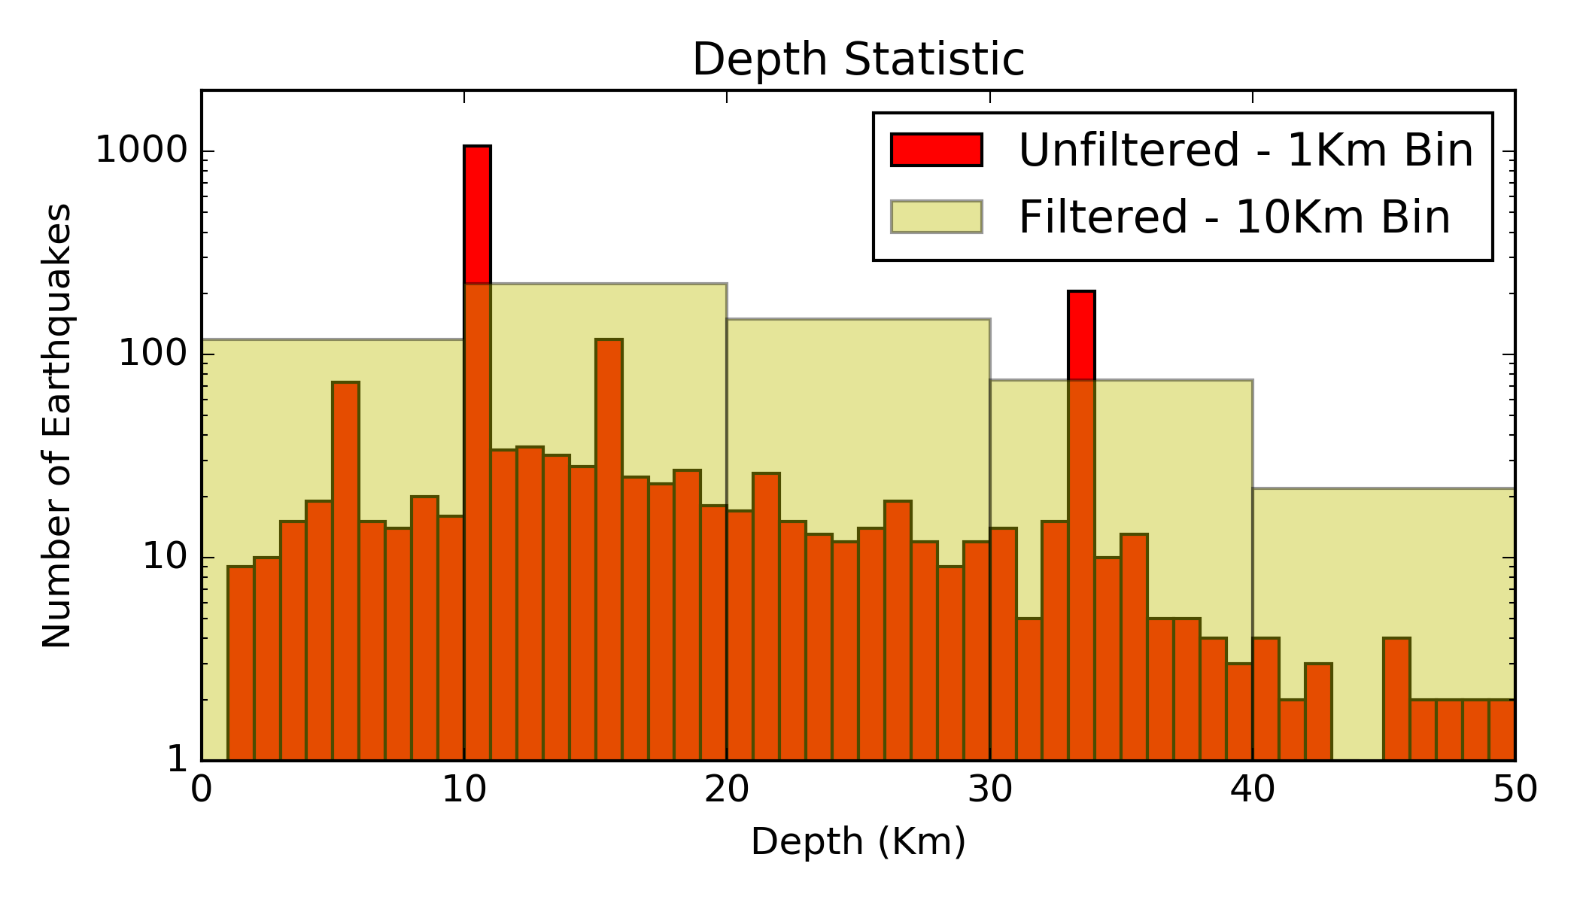
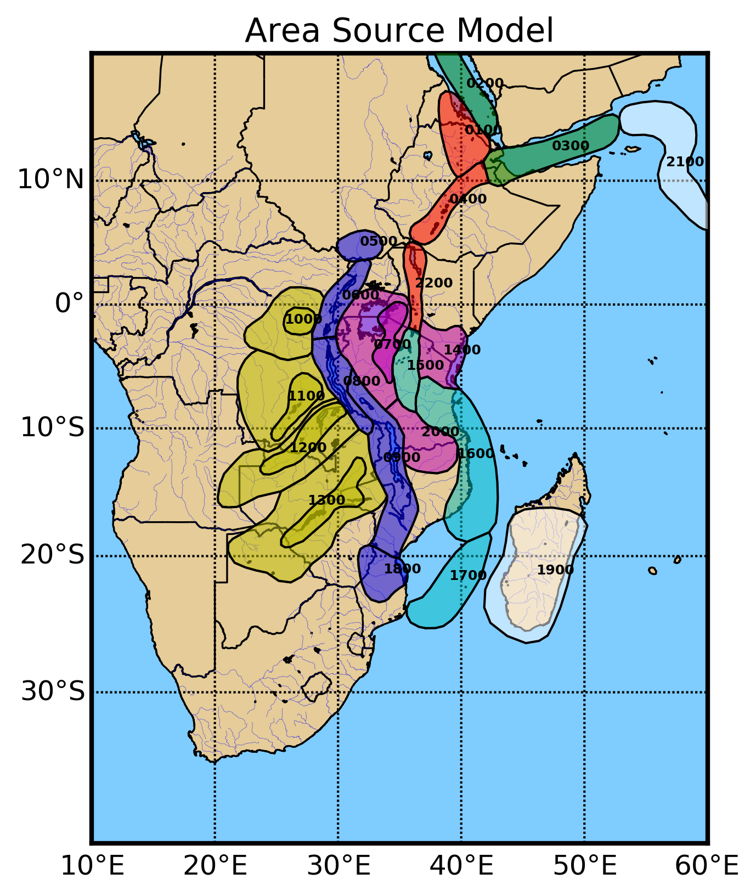
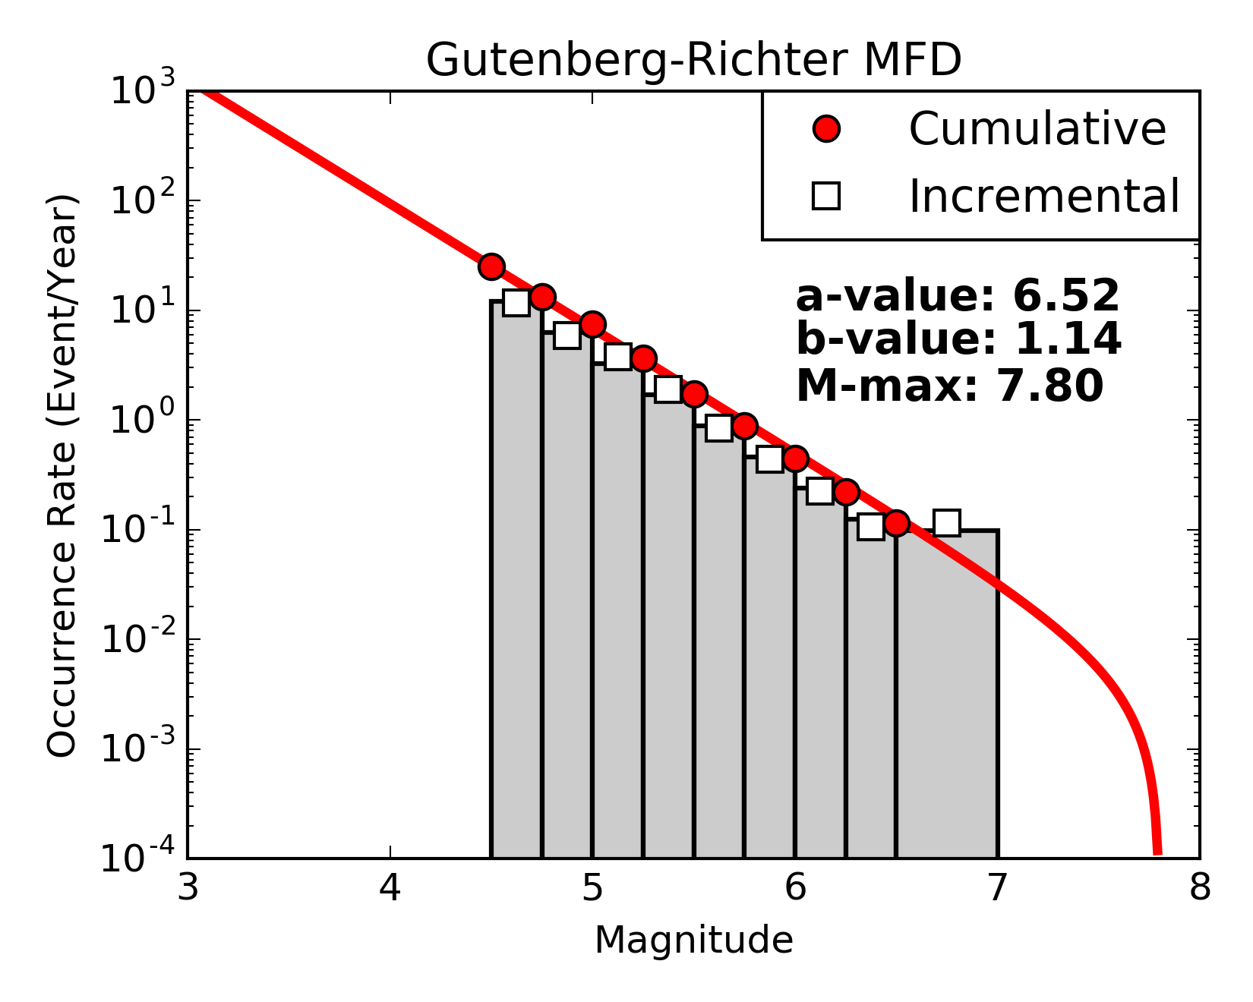
SSA Hazard Model – Regional Seismicity Analysis
Seismicity
Distribution
Earthquake
Source Zones
Earthquake Rates

Slide 12
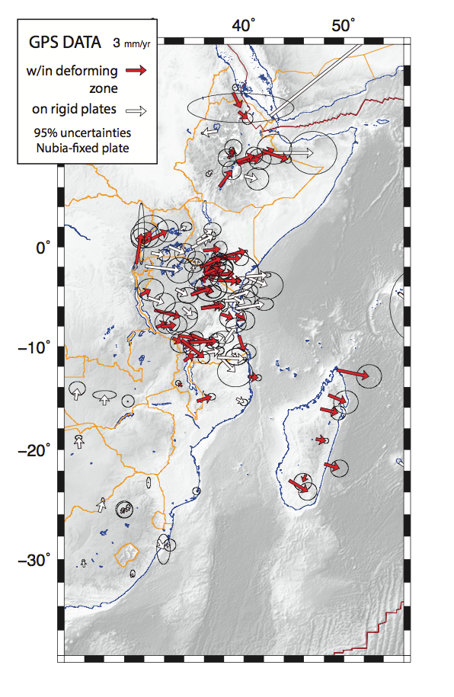
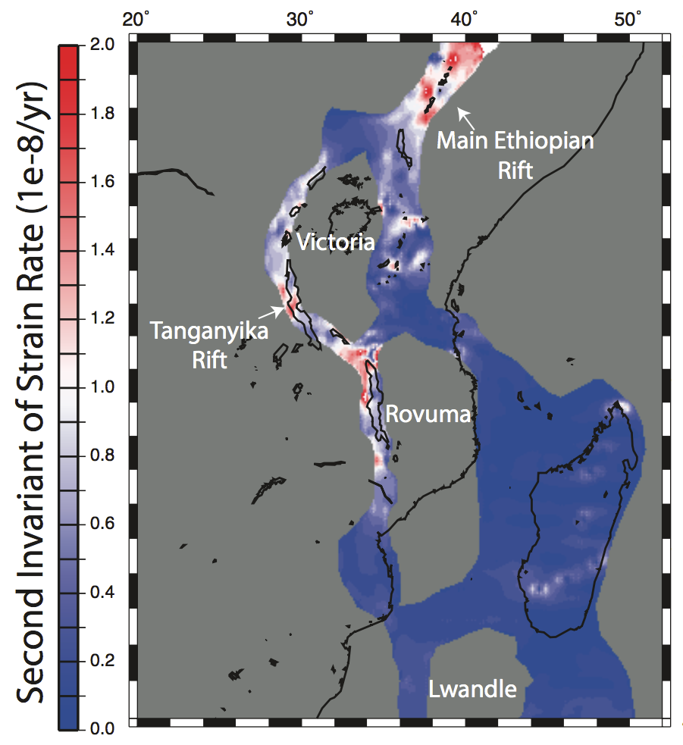
SSA Hazard Model – Strain Rate Model
A geodetic strain-rate model from observed GPS displacement have been elaborated with a collaboration between African and US scientists
Stamp et al. 2015

Slide 13
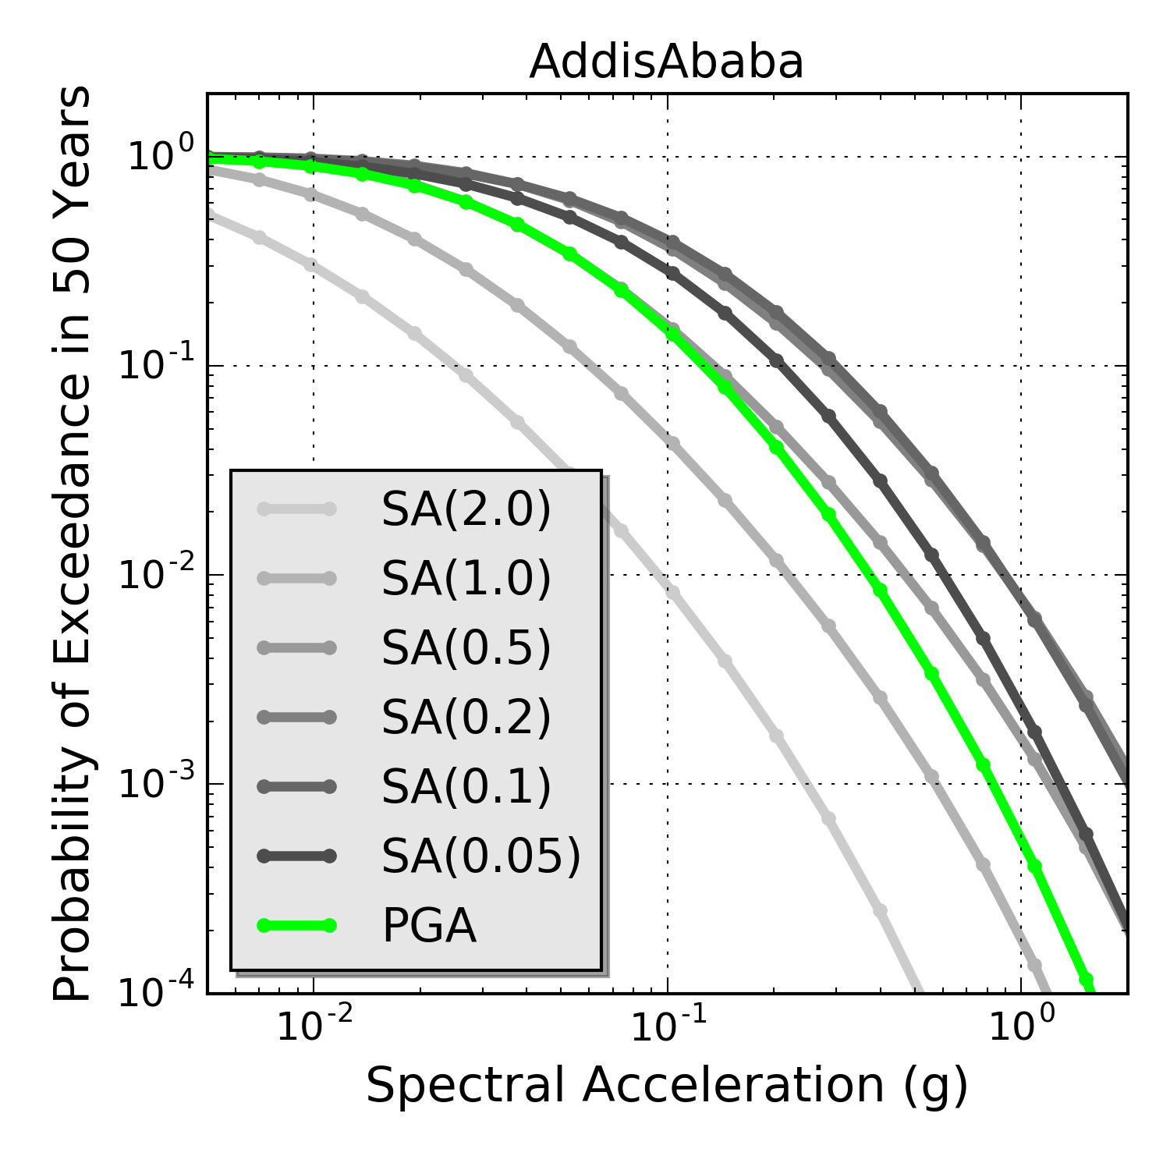
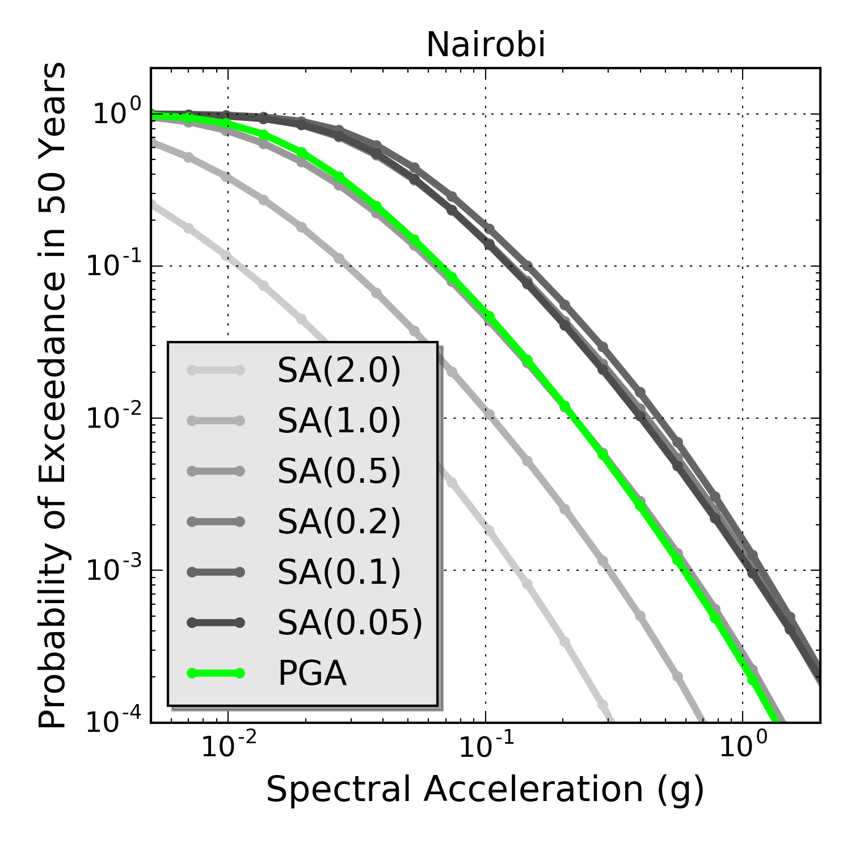
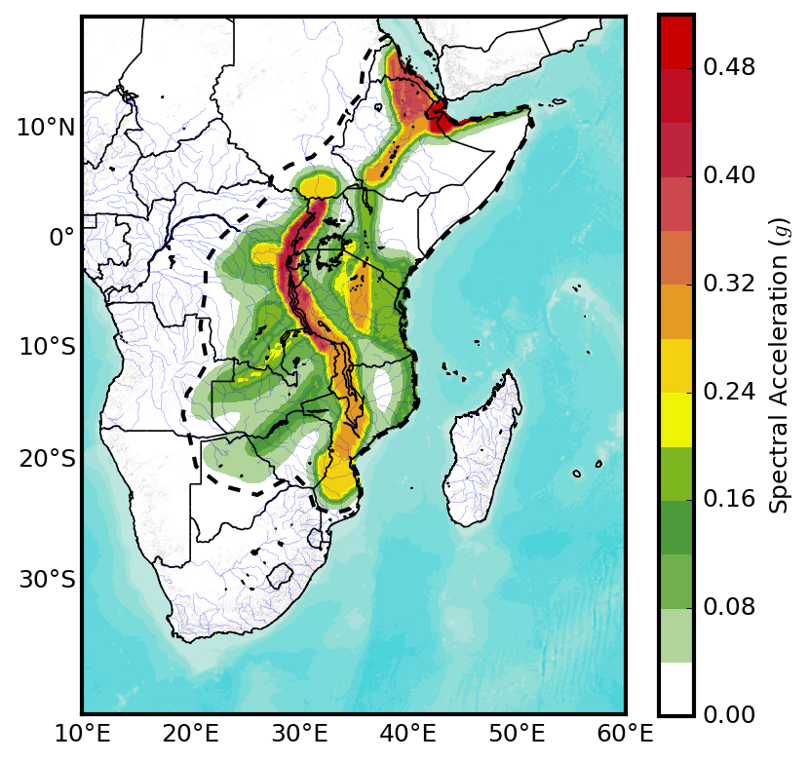
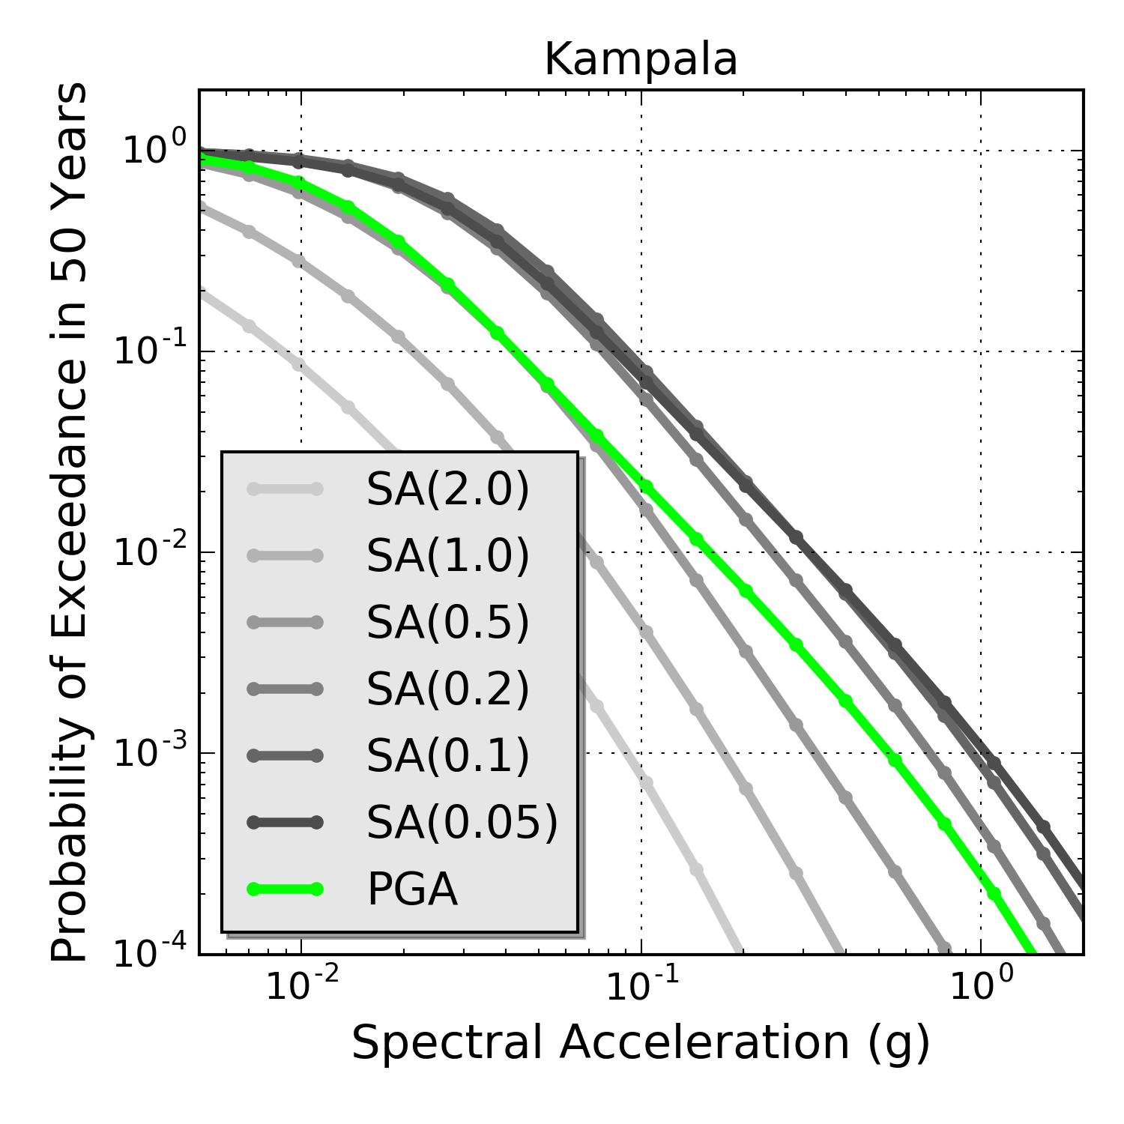
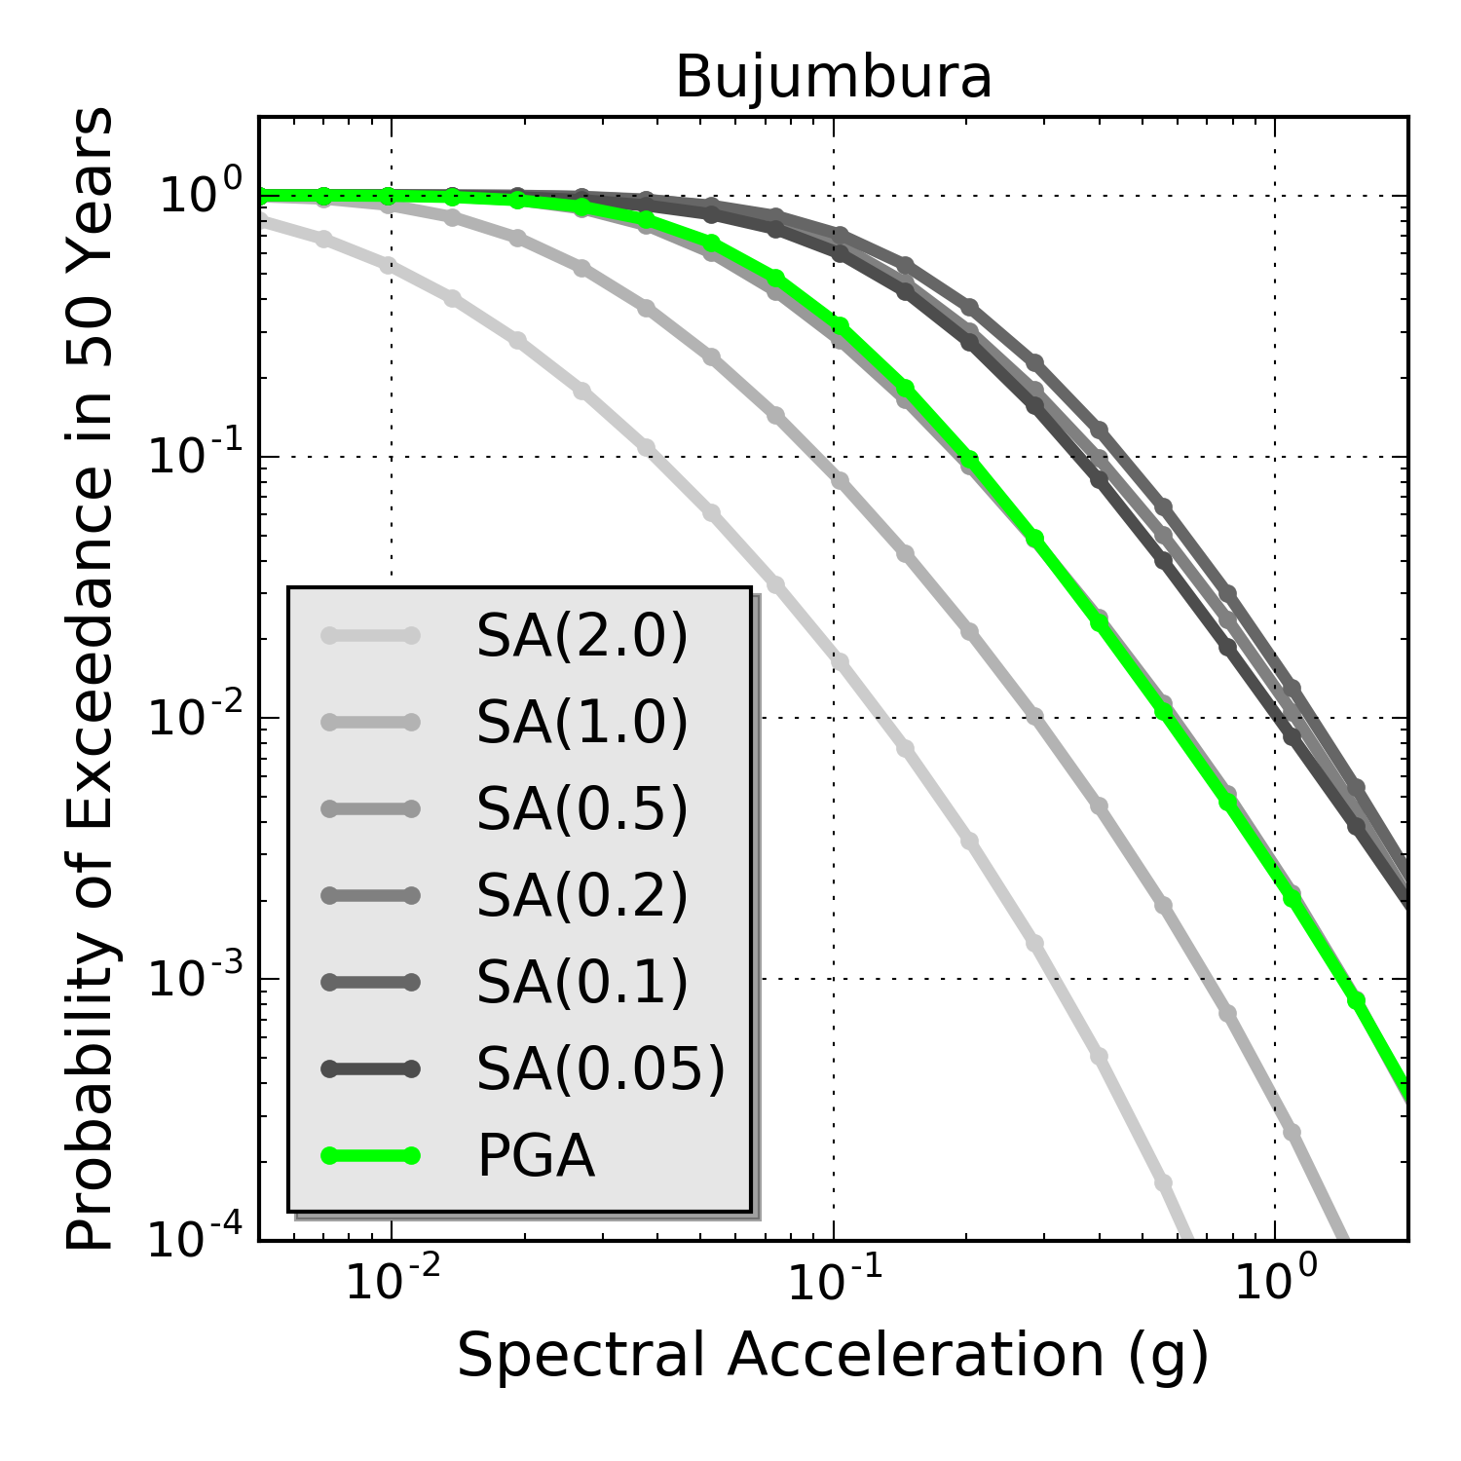
Hazard Curves @ African Capitals
Ethiopia
Kenya
Uganda
Burundi
0.2s
10% POE in 50 years

Slide 14
Missing Components
The SSA Hazard model is presently just in a pilot version, that will be eventually improved and expanded within future collaborations with African scientific community
Many components are still missing, such as:
Active faults information and paleoseismicity
Integration of local hazard studies
Strong motion recordings from local networks
Site-specific studies and microzonation
Need for a collaborative effort

Slide 15
Moving Forward
Outlook:
Review/integration of the open SSA model by African community
Integration of the model with new national models currently under development
Creation of a core group of experts on African hazard
Extend model to a continental scale
Extend model to a national scale and integrate with local building codes
What GEM is presently offering to make that happen:
High-level scientific expertise
Tested and openly available tools for earthquake hazard mitigation
Community-based development and networking
Support for initiatives at local and national scale
Training and capacity development

Slide 16
Thank you!
Except where otherwise noted, this work is licensed under https://creativecommons.org/licenses/by-nc-nd/3.0/
Please attribute to the GEM Foundation with a link to
www.globalquakemodel.org

